Slide 1
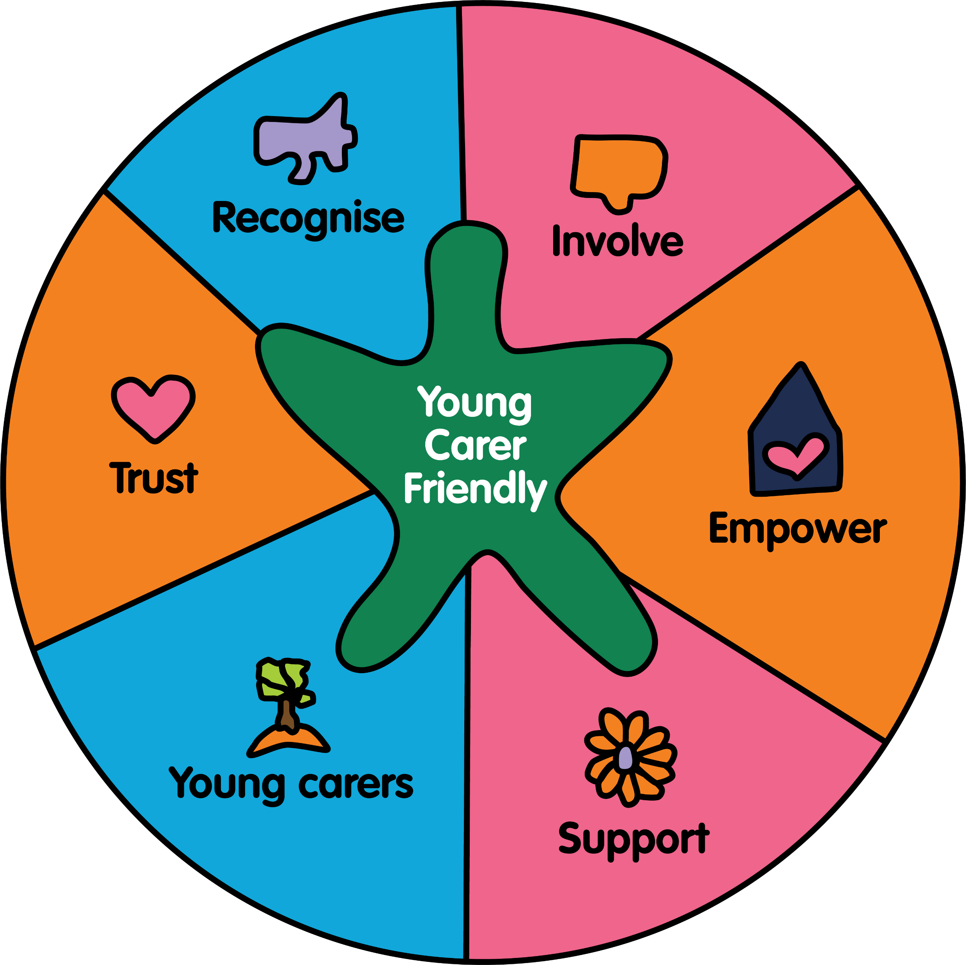
We are Young Carer Friendly Leeds
Leeds Young Carers Support Service
A bespoke package of support and training, which will assist a service or setting to review their current young carer identification and support mechanisms and establish a robust action plan, to improve outcomes for young carers.
Identify a Designated Lead for Young Carers (DLYC).
Create an environment and culture within your service or setting, where young carers and their families are visible, identified, supported and signposted.
Attend LYCSS Practice Development session/s.
Receive ongoing support from LYCSS, through action plan reviews.
.
leedsyoungcarers@family-action.org.uk
0113 733 9126
website

